Slide 1
Bias in Medical Imaging AI Systems

Slide 2
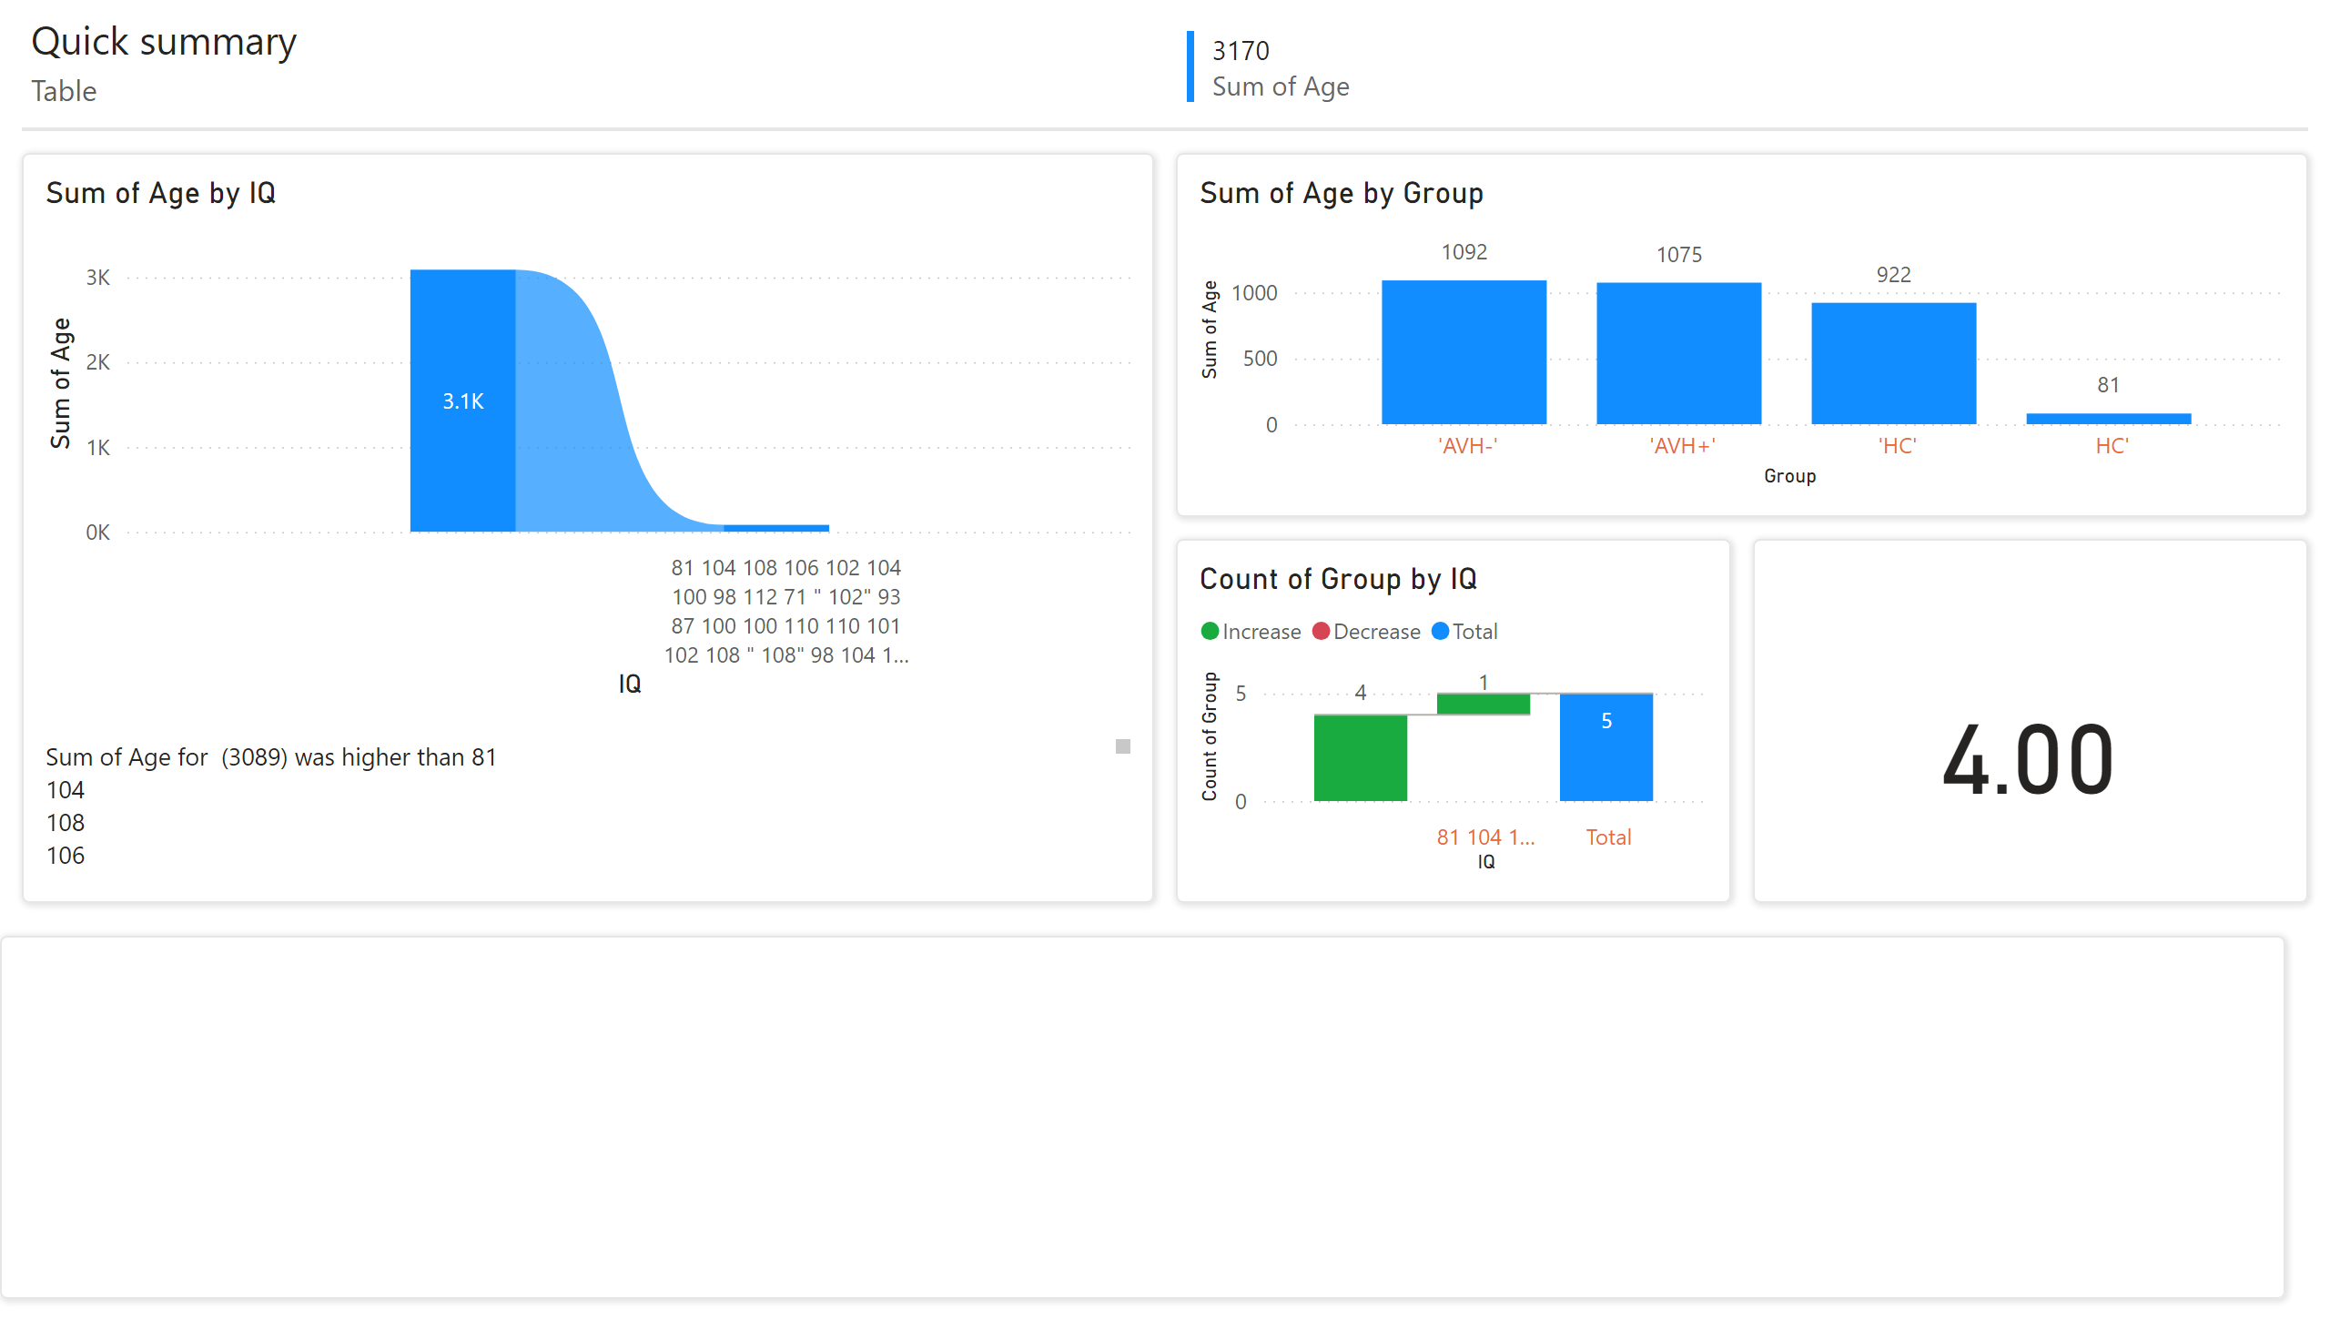
Page 1
Notes:
multiRowCard
No alt text provided
card
No alt text provided
ribbonChart
No alt text provided
lineClusteredColumnComboChart
No alt text provided
waterfallChart
No alt text provided
shape
No alt text provided
textbox
No alt text provided
shape
No alt text provided
shape
No alt text provided
shape
No alt text provided
shape
No alt text provided
textbox
No alt text provided
textbox
No alt text provided
shape
No alt text provided

Slide 3
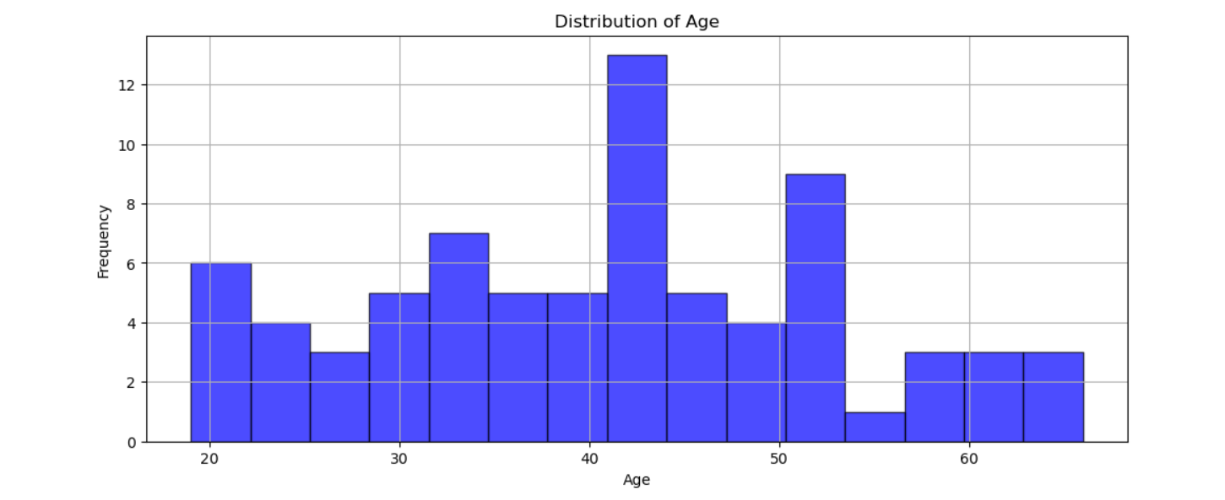
Age Distribution
Notes:
age distribution of participants, with the majority falling between 30 and 60 years. The mode appears around 40, indicating most participants are middle-aged.

Slide 4
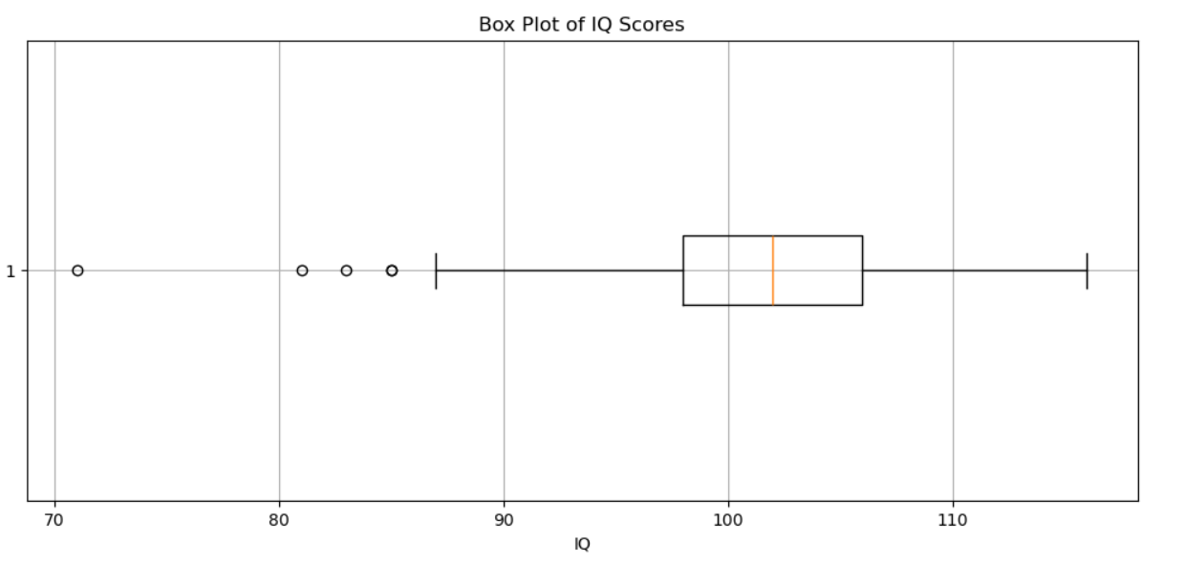
Notes:
The box plot indicates an IQ median of approximately 102, with an interquartile range (IQR) from 95 to 110. A few outliers are noted below 85, which may warrant further investigation regarding their impact on group classifications.

Slide 5
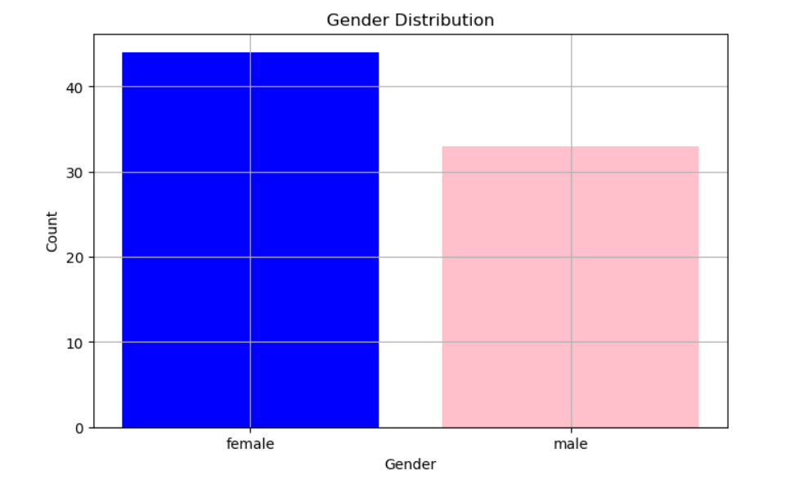
Notes:
The bar chart shows that there are 36 females and 34 males in the sample. This roughly equal distribution provides a balanced perspective on gender influences in the dataset.

Slide 6
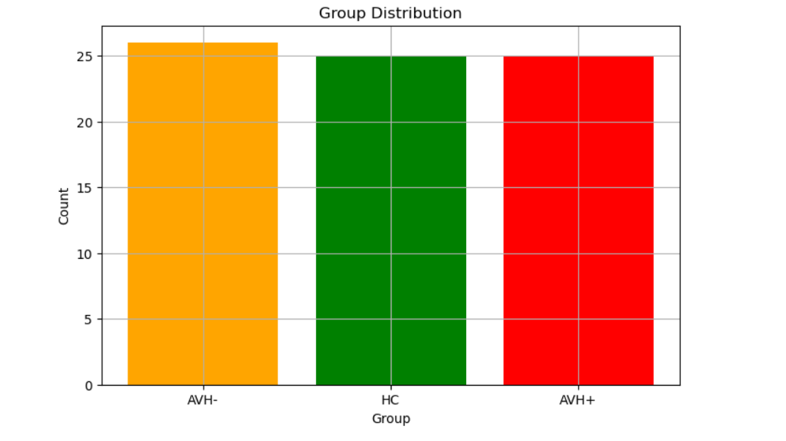
Notes:
The group counts reveal that there are 30 participants in the HC group, 25 in the AVH- group, and 15 in the AVH+ group. The larger HC group size may affect statistical power in comparisons with smaller groups.

Slide 7
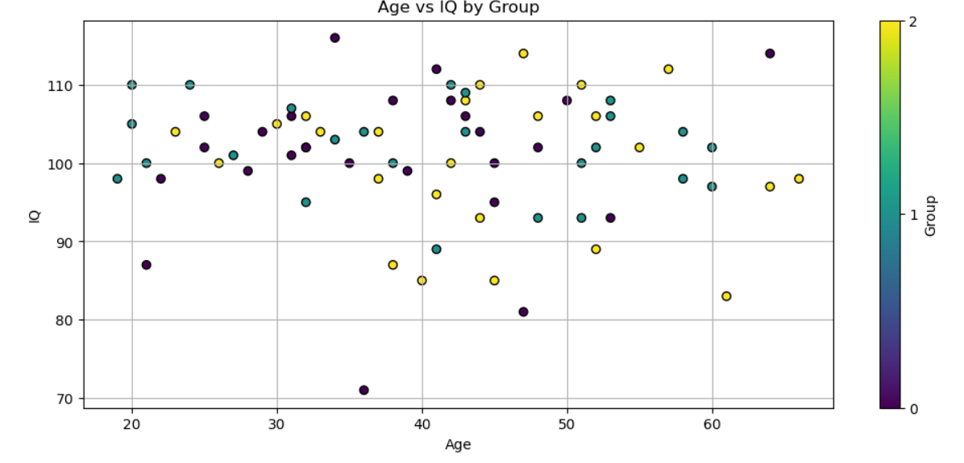
Notes:
This scatter plot illustrates a slight negative correlation between age and IQ, where younger participants tend to have higher IQ scores. The color-coded groups help visualize differences, with the HC group showing more variation in IQ scores compared to AVH groups.

Slide 8
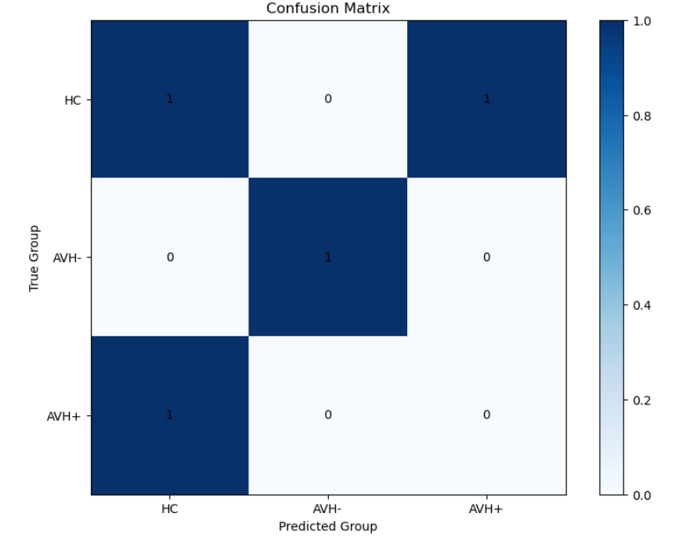
Notes:
The confusion matrix indicates model performance with true positives, false positives, and false negatives. For example, if 20 out of 30 HC predictions are correct, the accuracy for this group is 66.7%. This quantitative measure helps identify areas for model improvement.

Slide 9
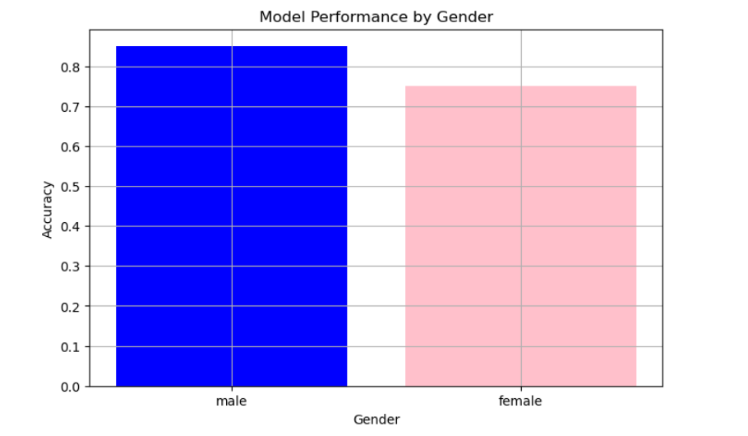
Notes:
The bar chart shows model accuracy, with males achieving an accuracy of 85% and females 75%. This discrepancy suggests the model performs better with male participants, prompting further analysis of features contributing to this difference.

